Slide 1
UM FINTECH BOOTCAMP PROJECT # 1
GERMAN VILLEGAS
FABIAN SEJAS
RAUL ZAJIA

Slide 2

OVERVIEW
Motory group is a car dealership group of used cars located on the north of Florida. The company has shared with us their year-to-date sales and we have clean and order some of their data.
The Main study of our project is to find what Car Make are the most profitable and if its a convenient business model reduced the Car Models that are traded.

Slide 3

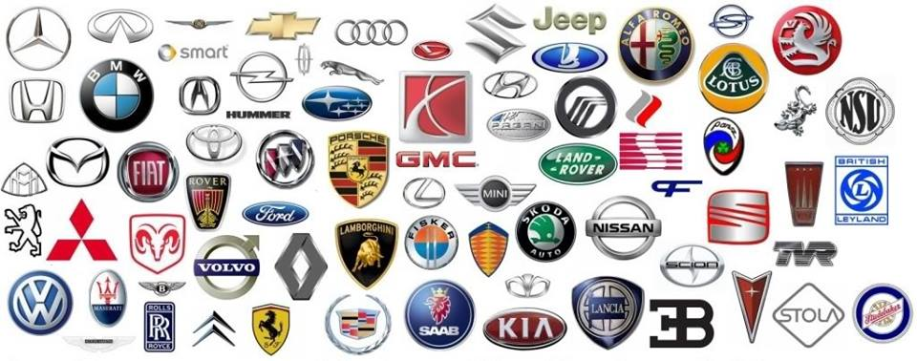




Slide 4
DATA INTERPRETATION
The data gave us extensive information about each closed deal, from the salesperson to the type of deal, information that even though is necessary for the company it was not relevant to our study.

Slide 5
CONCLUSION
After many hour “playing” with the data we found that there are only 5 Car Makes that made most of the sales. Of the top 5, HONDA and TOYOTA have the highest transactions and are by far the best option to trade. Other make are highly profitable by deal, that have a higher gross, but the volume of transaction are significantly lower.

